Slide 1
Presentation on
GPT-3
(Generative Pre-trained Transformer)

Slide 2
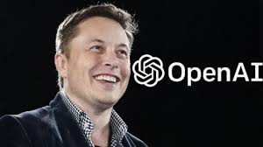
Its an artificial intelligence research laboratory founded in San Francisco by Elon Musk, Sam Altman and others.
OpenAI's mission is to ensure that artificial general intelligence (AGI)—by which we mean highly autonomous systems that outperform humans at most economically valuable work benefits all of humanity.
In the four short years of its existence, OpenAI has become one of the leading AI research labs in the world.
OpenAI's research tend to focus on reinforcement learning and is viewed as an important competitor to DeepMind.

Slide 3
History
As we all know that AI will change the world,GPT-3 is just an early glimpse of upcoming AI
This Gpt is the prediction model in the GPT-n series created by OpenAI, a San Francisco-based artificial intelligence research laboratory.
Generative Pre-trained Transformer (GPT) is an autoregressive language model that uses deep learning to produce human-like text.
They trained a large-scale unsupervised language model which generates coherent paragraphs of text.
As of now open ai created so many applications:
Gym
RoboSumo
Debate Game
Generative models –GPT, GPT-2 AND GPT-3.
Dactyl ,

Slide 4
GPT-3 Specifications
GPT-3 has 175 billion parameters
It almost trained with entire internet.
It has been trained with 45TB text data which include sources from wikipedia and books.
60% data for pre-trained GPT-3 model was taken from COMMON CRAWL,Common Crawl is organization that crawls the web and freely provides its archives and datasets to the public,it collect petabytes of data since 2011.
It has 96 decoded layers and it build on a system with 285k cpu cores,10k GPU’s, 400 gbps network connectivity for each gpu server.

Slide 5
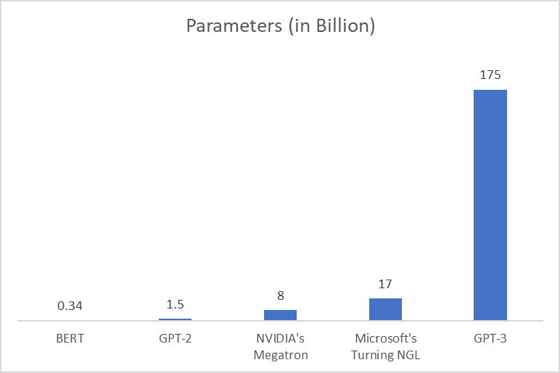
As we know that Bert is google’s natural language Processor and it has 0.34 billion parameters and NVIDIA’s megatron has 8 billion parameters and Microsoft NGL has 17 billion parameter, and gpt-2has 1.5 billion has not that much accuracy as gpt -3 , OpenAI researchers and engineers presented the original May 28, 2020 paper introducing GPT-3,as compare to all companies natural language processors and openai previous versions,the gpt-3 is created with 175 billion parameters and with 78% Accuracy.

Slide 6
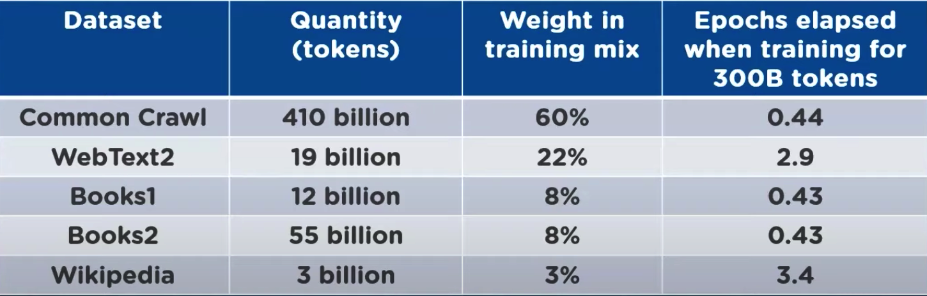
There are so many datasets that are used to train GPT-3 they are:

Slide 7

APPLICATIONS
1- CREATING SEARCH ENGINE: Using GPT-3 we can create a fully functional search engine, the advantage in this is if you given a question like what is the first mission of isro it direct display the answers under search button will URL.

Slide 8
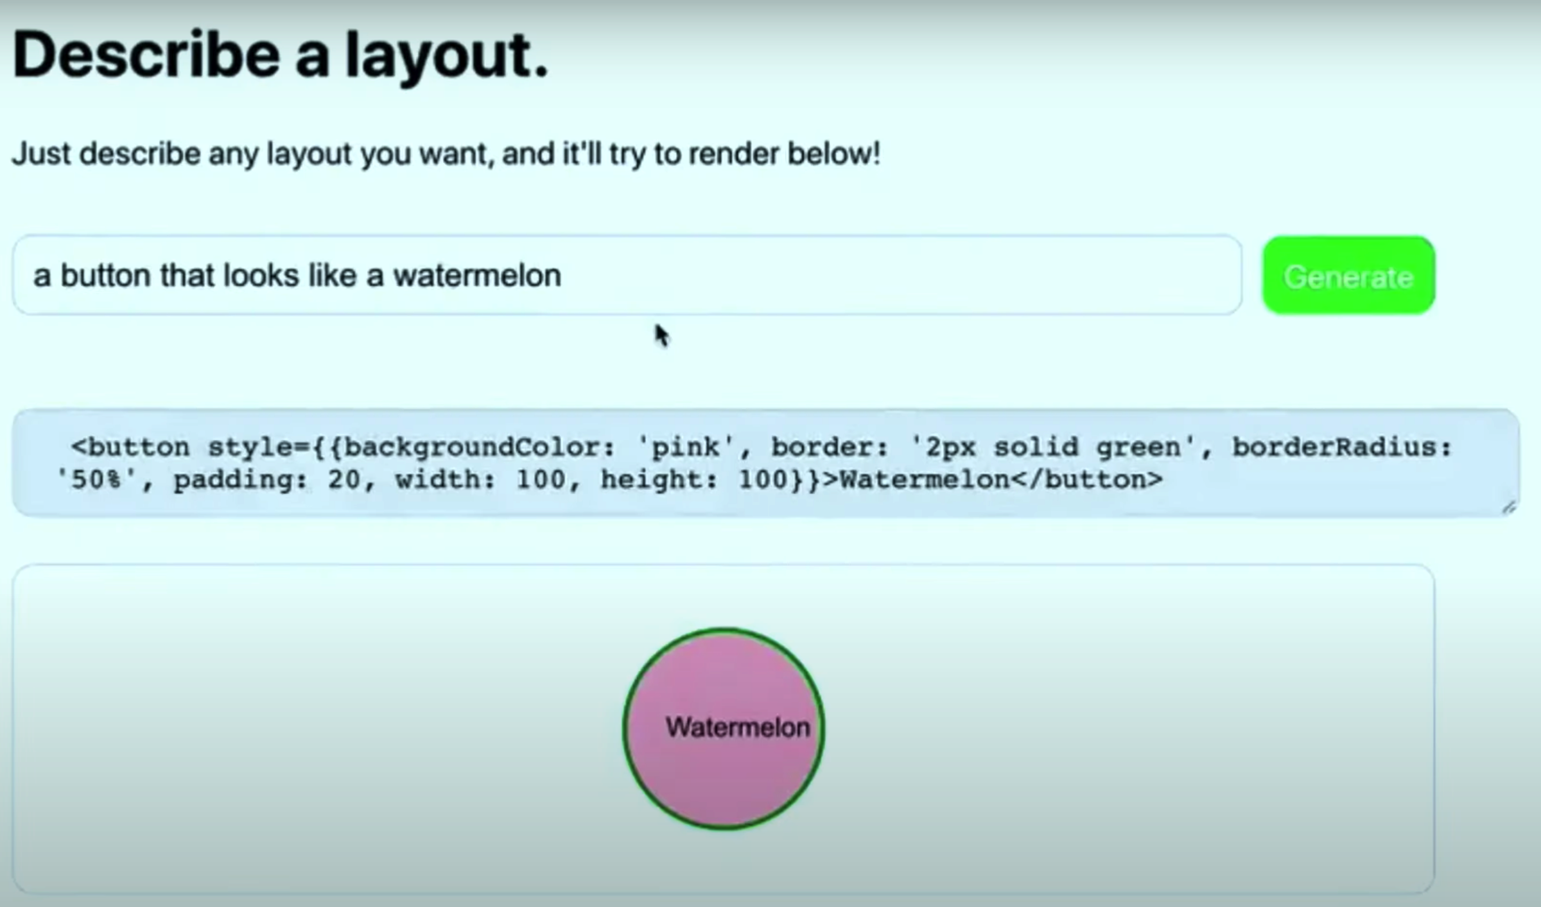
2-CODE GENERATOR:
This is the example code that was generated by gpt-3 here we can see that the user give a input in his own language,here we can see that the user want a button like watermelon so he given input like that then it gave him just that.

Slide 9
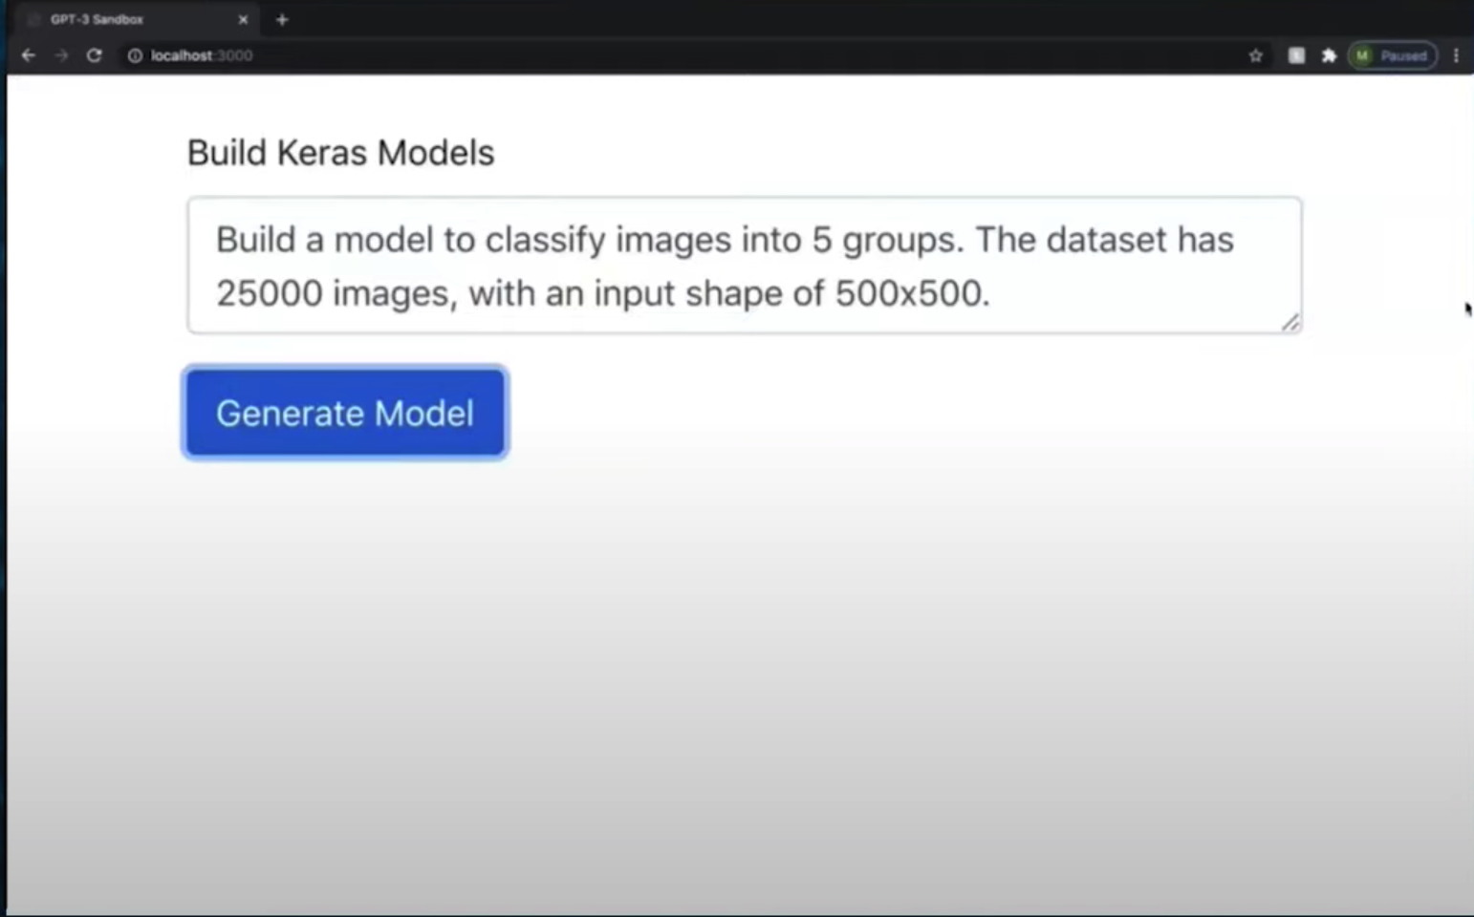
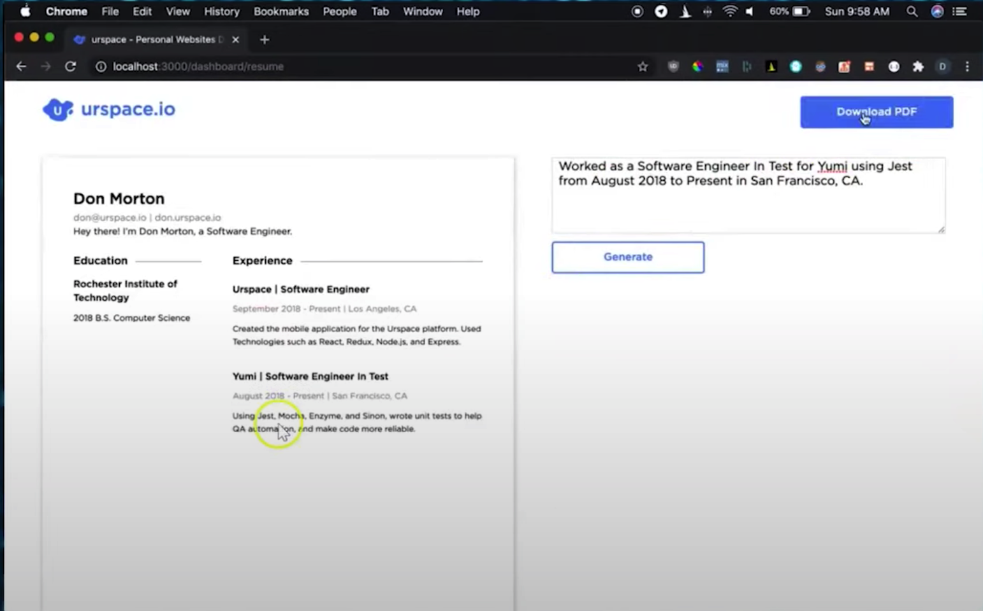
3-BUILDING KERAS MODELS:
In GPT-3 we can give a problem statement
in plain english then it generates a keras
code with in one min with the specifications
we need.
4- BUILD RESUMES: It is also used to build resumes also

Slide 10
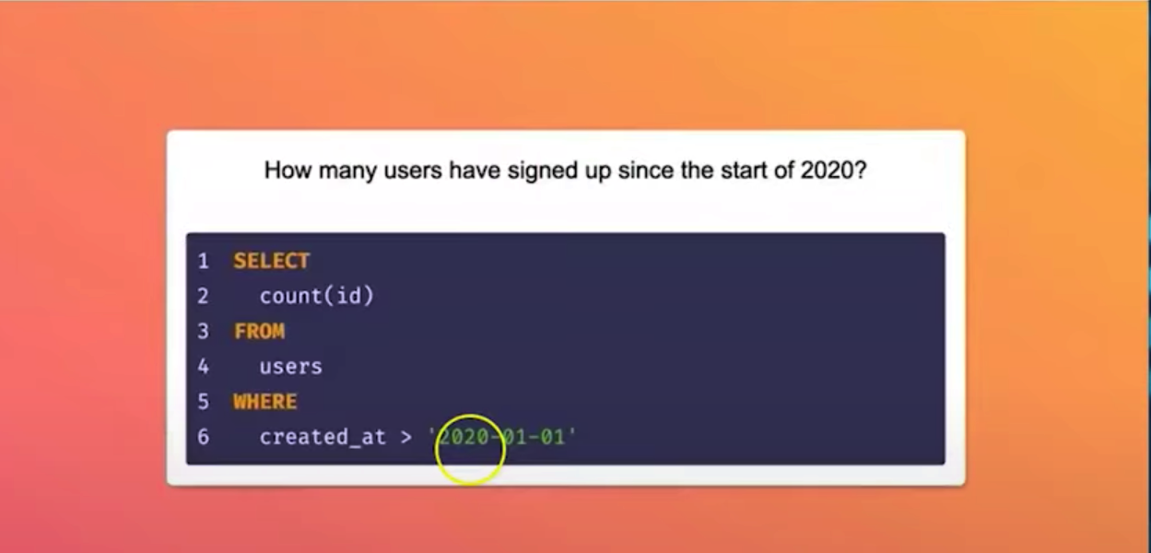
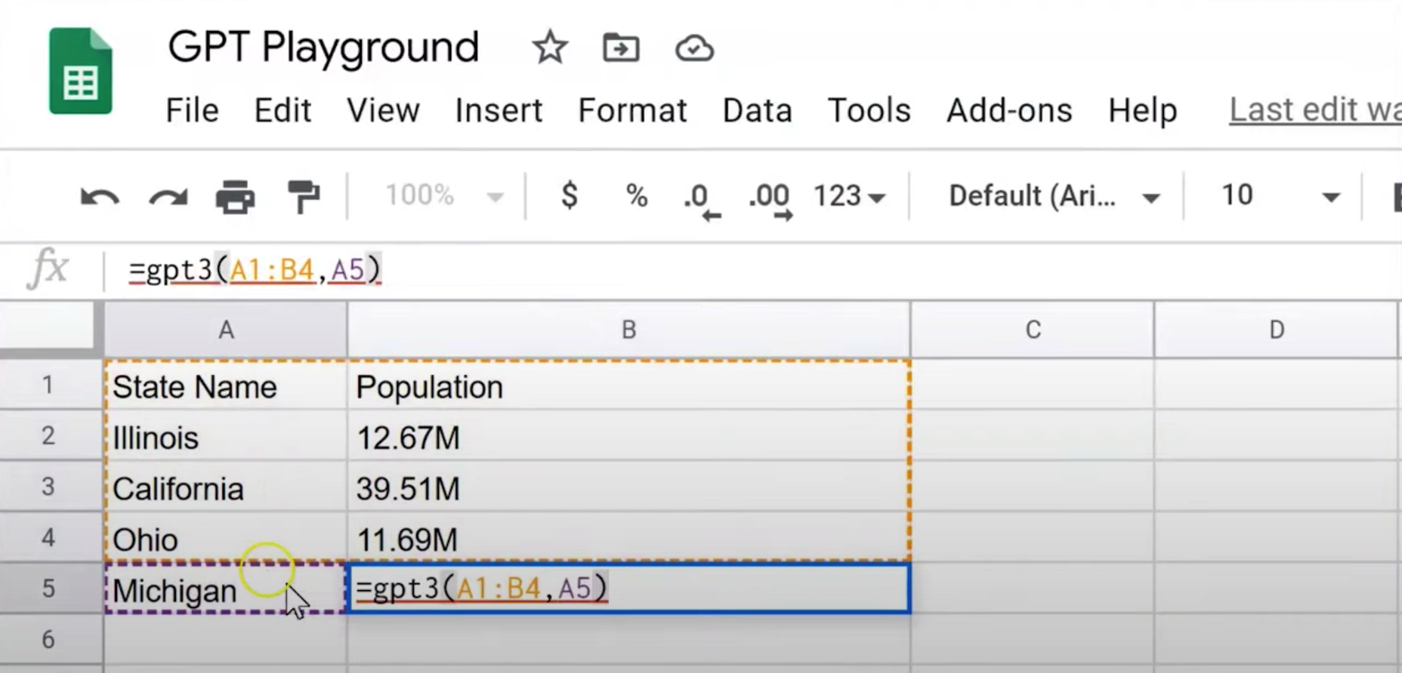
5-SQL QUERIES: It is also used to write sql queries too.
6-SPREADSHEET FUNCTION: Here in this we can see That the excel is have state names and their population If you want to know the population of any state then Select that table and give the state block as parameter Then then gpt-3 will search for the population of the state and return the result in few seconds.

Slide 11
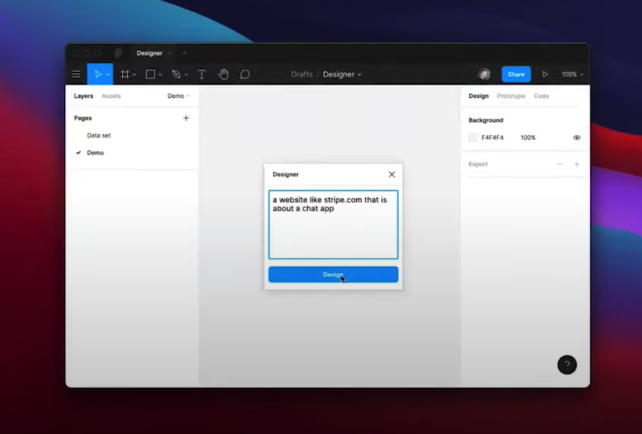
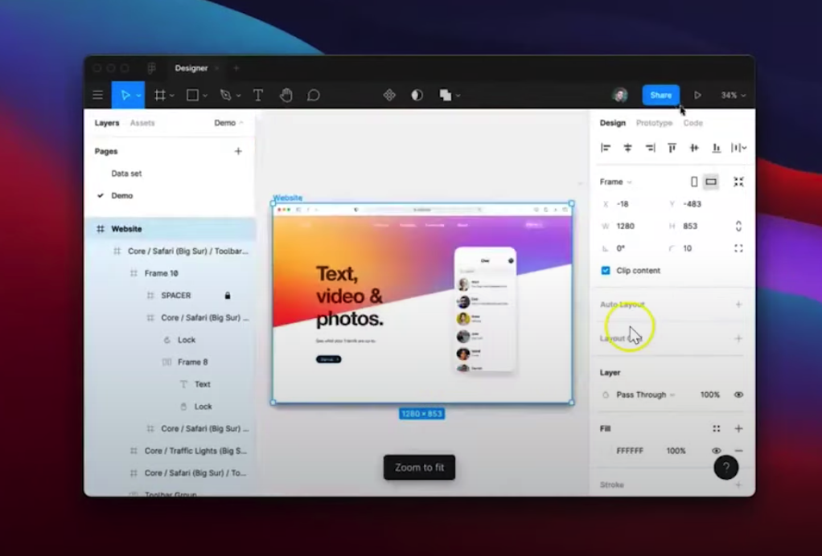
BUILDING WEB AND MOBILE APPLICATIONS: by using GPT_3 and its plugins we can create website and mobile apps,here we can give like to the app or website look like in plain english,GPT-3 will decode that and the output will be exactly like how you feel like it would be ,here is the examples for that

Slide 12
More Applications...
For writing podcast
For JavaScript API
Code oracle, ML.
for meme creation
JSX Layout Maker
Regex generator
The AI recursion
Understanding code
Tweeting
Meme generator

Slide 13
Frequently occurred questions after GPT-3 launch
Does gpt-3 have limitations?
Although results are impressive at first glance, GPT-3 has massive limitations. GPT-3 doesn't have any kind of understanding of what these words actually mean, because it is not based on a semantic representation of the real world. Simply put, GPT-3 lacks true common sense.
Is gpt-3 a neural network? The scale of this dynamic "weighting" process is what makes GPT-3 the largest artificial neural network ever created.
Can gpt-3 write code?
More Than Code — GPT-3 Applied to Any Language Task .So, while you can direct GPT-3 to write code, you can also direct it to write poetry, music, social media comments, or any other text.
How good is GPT-3? - GPT-3 is the most powerful language model ever in the world.

